Slide 1
Flow Free
On applying Quantum Annealing for the game

Slide 2
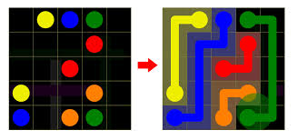
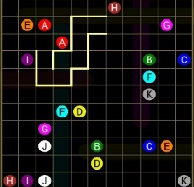

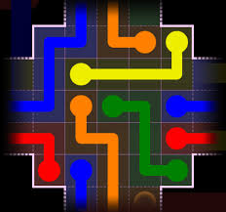
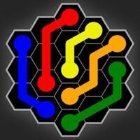
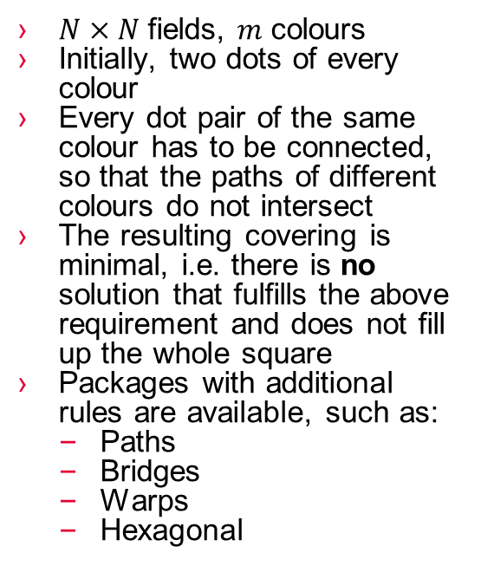
Flow free
$N×N$fields, $m$ colours
Initially, two dots of every colour
Every dot pair of the same colour has to be connected, so that the paths of different colours do not intersect
The resulting covering is minimal, i.e. there is no solution that fulfills the above requirement and does not fill up the whole square
Packages with additional rules are available, such as:
Paths
Bridges
Warps
Hexagonal

Slide 3
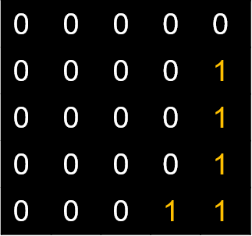
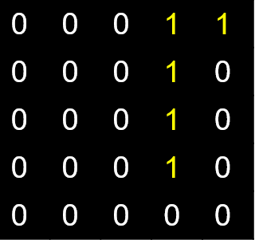
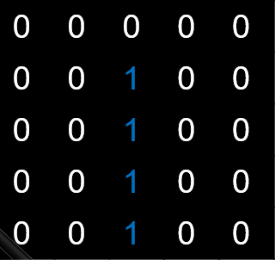
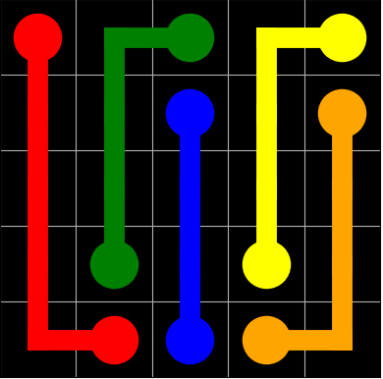
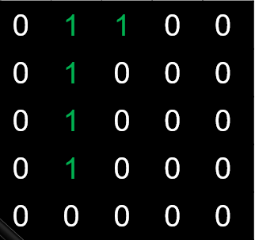
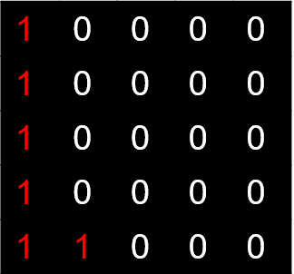


Optimization problem
Use one qubit per colour in every field
$N^{2}C$ for $C$ colours
$x_{x,y,c}=1$: field $\left(x,y\right)∈{\left[N\right]}^{2}$ has colour $c∈[C]$
$$x_{1,2,3}$$

Slide 4
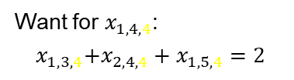
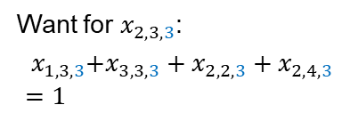
First Idea
Every start or endpoint has exactly one neighbour with the same colour, every other field has exactly two if the corresponding field is 1
Want for $x_{2,3,3}$:
$${ x}_{1,3,3}+x_{3,3,3}+x_{2,2,3}+x_{2,4,3}=1$$
Want for $x_{1,4,4}$:
$${ x}_{1,3,4}+x_{2,4,4}+x_{1,5,4}=2$$

Slide 5

Optimization problem cont’d
Further, we only want one colour per field!
Solution: Allow exactly one colour per field, i.e. add the summand
${\sum_{p∈{\left[N\right]}^{2}}{(\sum_{c∈[C]}{x_{p,c}}−1})}^{2}$

Slide 6
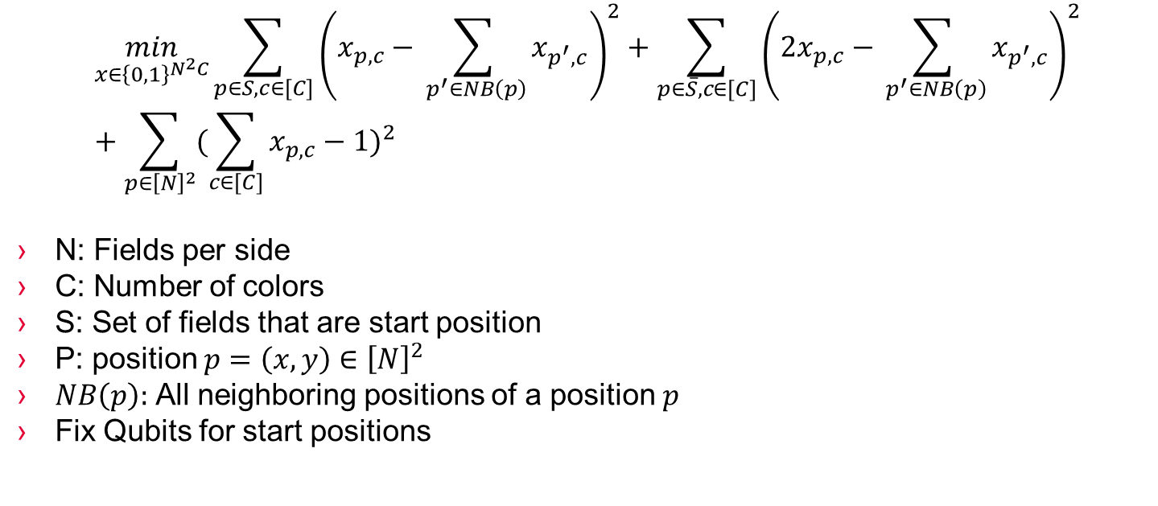
Optimization form
$$\min_{x∈{\left\{0,1\right\}}^{N^{2}C}}\sum_{p∈S, c∈[C]}{{\left(x_{p,c}−\sum_{ p^{′}∈NB\left(p\right)}{x_{p^{′},c}}\right)}^{2}}+\sum_{p∈\overline{S}, c∈[C]}{{\left({2x}_{p,c}−\sum_{ p^{′}∈NB\left(p\right)}{x_{p^{′},c}}\right)}^{2}}+{\sum_{p∈{\left[N\right]}^{2}}{(\sum_{c∈[C]}{x_{p,c}}−1})}^{2}$$
N: Fields per side
C: Number of colors
S: Set of fields that are start position
P: position $p=\left(x,y\right)∈{\left[N\right]}^{2}$
$NB\left(p\right):$ All neighboring positions of a position $p$
Fix Qubits for start positions

Slide 7
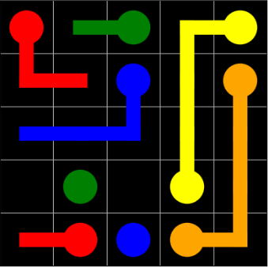
Test
Qubo Energy is 48.0 > 0
Solutions that D-Wave found yield Energy > 48.0
100 reads do not yield the optimal solution
Idea: Plot Error map for further investigations

Slide 8
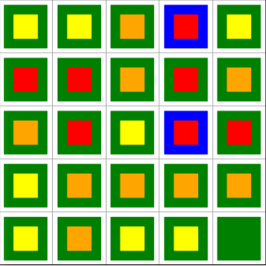
Error Map
Error caused by more (or less) than one colour per field
Error caused by wrong number of neighbours

Slide 9
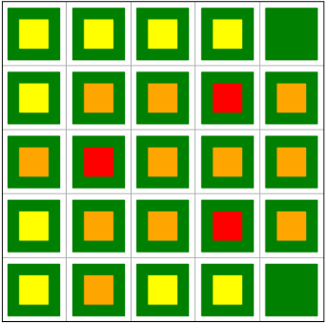

Test
Observation: Correct solution leads to punishments!
Energy = 48.0 is not an offset, but a shortcoming of the model
Problem: When $x_{p,c}=0$, the wrong number of neighbours still affects the energy! We do not want that

Slide 10
Test
Observation: Correct solution leads to punishments!
Energy = 48.0 is not an offset, but a shortcoming of the model
Problem: When $x_{p,c}=0$, the wrong number of neighbours still affects the energy! We do not want that

Slide 11
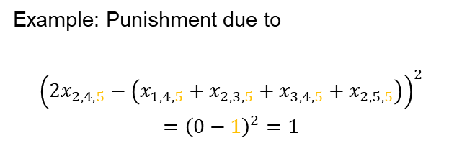
Test
Example: Punishment due to
$${\left(2x_{2,4,5}−\left(x_{1,4,5}+x_{2,3,5}+x_{3,4,5}+x_{2,5,5}\right)\right)}^{2}$$
$$={\left(0−1\right)}^{2}=1$$

Slide 12
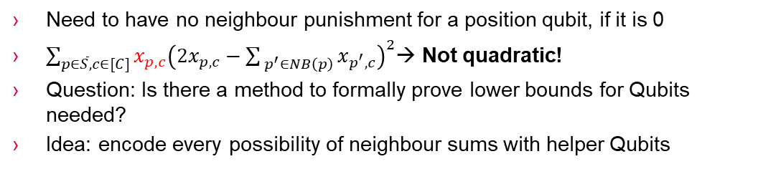
Idea: Need helper bits
Need to have no neighbour punishment for a position qubit, if it is 0
$\sum_{p∈\overline{S}, c∈[C]}{x_{p,c}{\left({2x}_{p,c}−\sum_{ p^{′}∈NB\left(p\right)}{x_{p^{′},c}}\right)}^{2}}$→ Not quadratic!
Question: Is there a method to formally prove lower bounds for Qubits needed?
Idea: encode every possibility of neighbour sums with helper Qubits

Slide 13

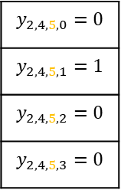

Optimization problem
Use one qubit per colour in every field
$N^{2}C$ for $C$ colours
$x_{x,y,c}=1$: field $\left(x,y\right)∈{\left[N\right]}^{2}$ has colour $c∈[C]$
$y_{x,y,c,n}=1: \sum_{ p^{′}∈NB\left(p\right)}{x_{p^{′},c}}=n$
$$x_{1,2,3}$$
$$y_{2,4,5,0}=0$$
$$y_{2,4,5,1}=1$$
$$y_{2,4,5,2}=0$$
$$y_{2,4,5,3}=0$$

Slide 14
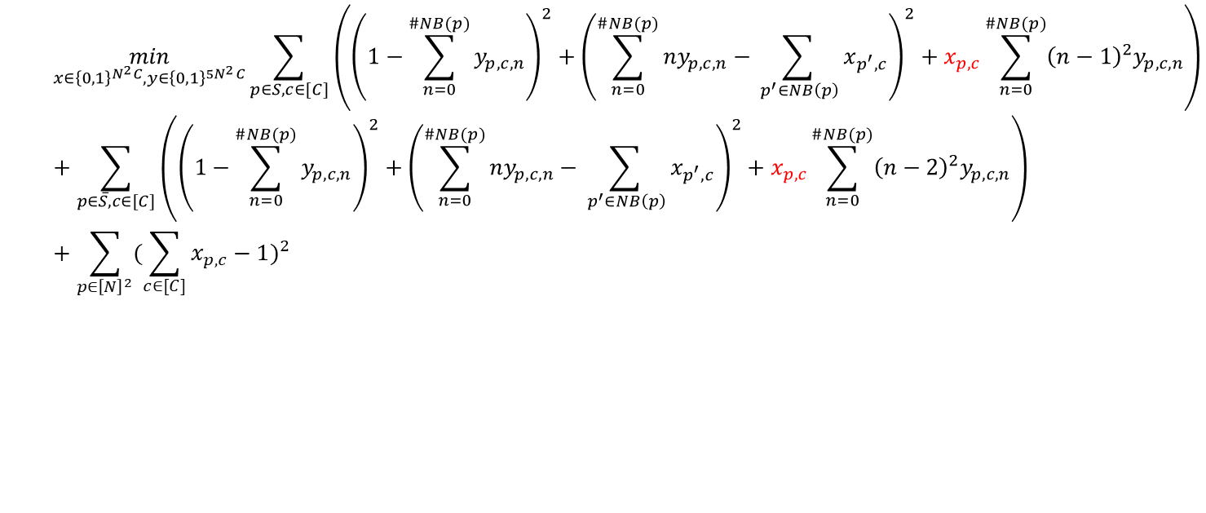
Qubo problem
$$\min_{x∈{\left\{0,1\right\}}^{N^{2}C}, y∈{\left\{0,1\right\}}^{{5N}^{2}C}}\sum_{p∈S, c∈[C]}{\left({\left(1−\sum_{n=0}^{\#NB(p)}{y_{p,c,n}}\right)}^{2}+{\left(\sum_{n=0}^{\#NB(p)}{{ny}_{p,c,n}}−\sum_{ p^{′}∈NB\left(p\right)}{x_{p^{′},c}}\right)}^{2}+x_{p,c}\sum_{n=0}^{\#NB(p)}{{{\left(n−1\right)}^{2}y}_{p,c,n}}\right)}+\sum_{p∈\overline{S}, c∈[C]}{\left({\left(1−\sum_{n=0}^{\#NB(p)}{y_{p,c,n}}\right)}^{2}+{\left(\sum_{n=0}^{\#NB(p)}{{ny}_{p,c,n}}−\sum_{ p^{′}∈NB\left(p\right)}{x_{p^{′},c}}\right)}^{2}+x_{p,c}\sum_{n=0}^{\#NB(p)}{{{\left(n−2\right)}^{2}y}_{p,c,n}}\right)}+{\sum_{p∈{\left[N\right]}^{2}}{(\sum_{c∈[C]}{x_{p,c}}−1})}^{2}$$

Slide 15
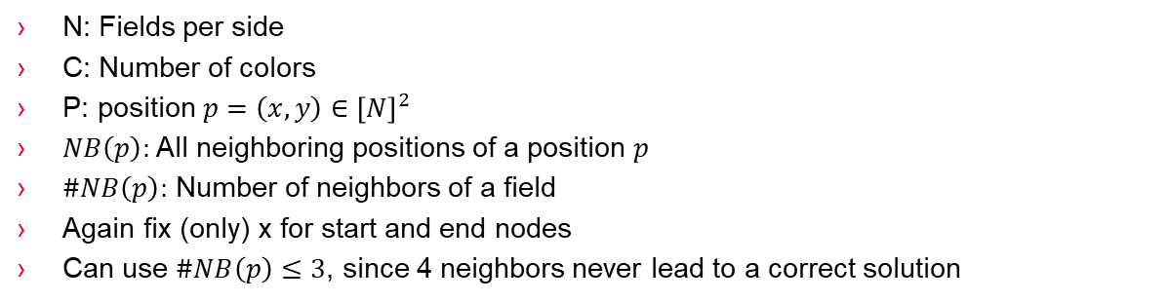

„Simplifies“ to
$$\min_{x∈{\left\{0,1\right\}}^{N^{2}C}, y∈{\left\{0,1\right\}}^{{5N}^{2}C}}\sum_{p∈{\left[N\right]}^{2}, c∈[C]}{\left({\left(1−\sum_{n=0}^{\#NB(p)}{y_{p,c,n}}\right)}^{2}+{\left(\sum_{n=0}^{\#NB(p)}{{ny}_{p,c,n}}−\sum_{ p^{′}∈NB\left(p\right)}{x_{p^{′},c}}\right)}^{2} \right)+\sum_{p∈{\left[N\right]}^{2}}{{\left(\sum_{c∈\left[C\right]}{x_{p,c}}−1\right)}^{2}}}+\sum_{p∈\overline{S}, c∈[C]}{x_{p,c}\left(\sum_{n=0}^{\#NB(p)}{{{\left(n−2\right)}^{2}y}_{p,c,n}}\right)}+\sum_{p∈S, c∈[C]}{x_{p,c}\left(\sum_{n=0}^{\#NB(p)}{{{\left(n−1\right)}^{2}y}_{p,c,n}}\right)}$$
N: Fields per side
C: Number of colors
P: position $p=\left(x,y\right)∈{\left[N\right]}^{2}$
$NB\left(p\right):$ All neighboring positions of a position $p$
$\#NB\left(p\right):$ Number of neighbors of a field
Again fix (only) x for start and end nodes
Can use $\#NB\left(p\right)≤3$, since 4 neighbors never lead to a correct solution

Slide 16
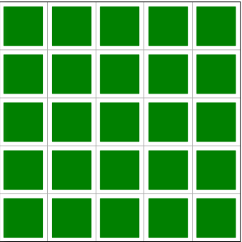
Results
Implementation finished
When testing with giving the solution sample, we get Energy = 0.0!
Error plot for solution sample looks good!
When running on D-Wave:
Error ☹ „No Embedding found“
In the Embedding function, a graph problem has to be solved in order to map Qubo problem to the QPU
Success depends on:
Problem size
Problem structure
→ Smaller Problem!

Slide 17
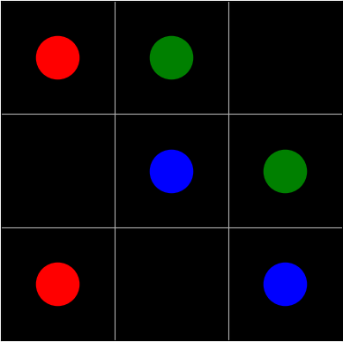
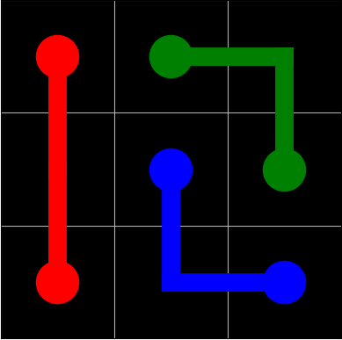
Results (3x3) trivial flow problem
Solution found!
Playing around with constraints neccessary, the following relation seems to be optimal:
Exactly one colour per field: 3
Exactly one helper per field, colour equals 1: 2
Rest: 1

Slide 18
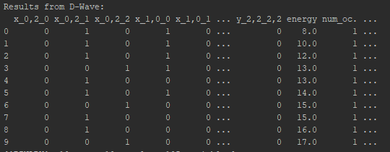
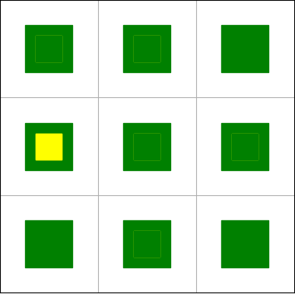

Results (3x3) trivial flow problem notes
Correct x can be found without finding optimum (i.e. also correct y)
Error map not representative anymore when using helper bits
Scaleability: Need $O(N^{2}C)$ Qubits (helper Qubits are only a constant factor, still have a high impact with todays QPUs)
With encoding, might be possible to only use $O(N^{2}logC)$ Qubits

Slide 20
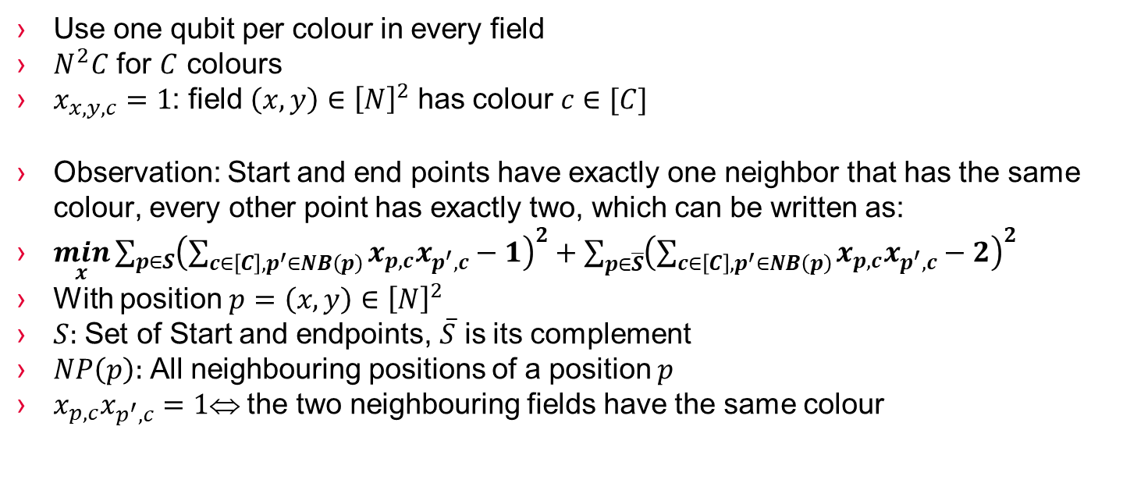
Optimization problem
Use one qubit per colour in every field
$N^{2}C$ for $C$ colours
$x_{x,y,c}=1$: field $\left(x,y\right)∈{\left[N\right]}^{2}$ has colour $c∈[C]$
Observation: Start and end points have exactly one neighbor that has the same colour, every other point has exactly two, which can be written as:
$\min_{x}\sum_{p∈S}{{\left(\sum_{c∈\left[C\right], p^{′}∈NB\left(p\right)}{x_{p,c}x_{p^{′},c}}−1\right)}^{2}}+\sum_{p∈\overline{S}}{{\left(\sum_{c∈\left[C\right], p^{′}∈NB\left(p\right)}{x_{p,c}x_{p^{′},c}}−2\right)}^{2}}$
With position $p=\left(x,y\right)∈{\left[N\right]}^{2}$
$S:$ Set of Start and endpoints, $\overline{S}$ is its complement
$NP\left(p\right):$ All neighbouring positions of a position $p$
$x_{p,c}x_{p^{′},c}=1$ the two neighbouring fields have the same colour

Slide 21
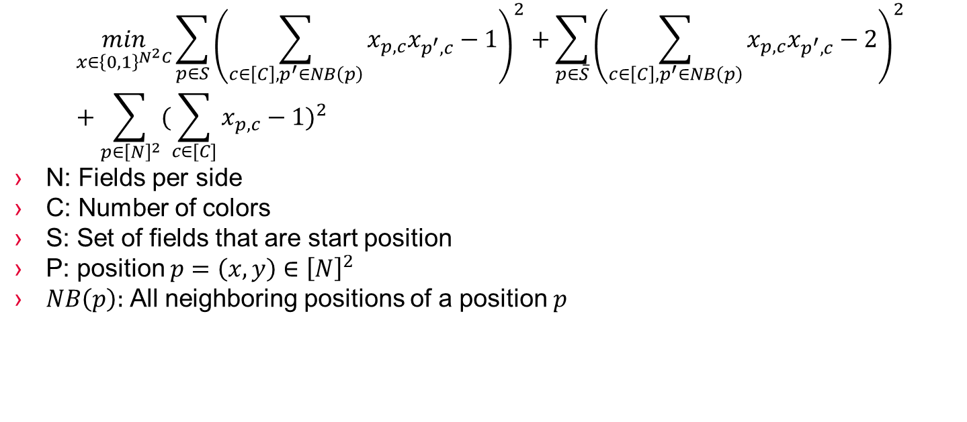
Optimization form
$$\min_{x∈{\left\{0,1\right\}}^{N^{2}C}}\sum_{p∈S}{{\left(\sum_{c∈\left[C\right], p^{′}∈NB\left(p\right)}{x_{p,c}x_{p^{′},c}}−1\right)}^{2}}+\sum_{p∈\overline{S}}{{\left(\sum_{c∈\left[C\right], p^{′}∈NB\left(p\right)}{x_{p,c}x_{p^{′},c}}−2\right)}^{2}}+{\sum_{p∈{\left[N\right]}^{2}}{(\sum_{c∈[C]}{x_{p,c}}−1})}^{2}$$
N: Fields per side
C: Number of colors
S: Set of fields that are start position
P: position $p=\left(x,y\right)∈{\left[N\right]}^{2}$
$NB\left(p\right):$ All neighboring positions of a position $p$

Slide 22
Not working yet, because it is not quadratic
Rewrite: (xp +sum(xNB(p))(xp +sum(xNB(p))-3)/#neighbours not minimal at 0
Substitute xaxb with a helper y that is like an and gate or knapsack, whatever think more about it

Slide 23
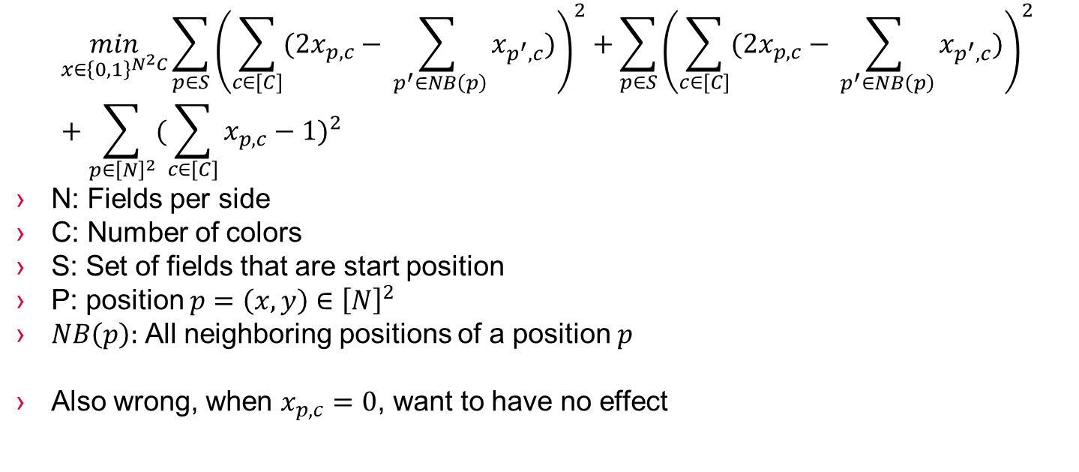
Maybe also try
$$\min_{x∈{\left\{0,1\right\}}^{N^{2}C}}\sum_{p∈S}{{\left(\sum_{c∈[C]}{(2x_{p,c}−\sum_{ p^{′}∈NB\left(p\right)}{x_{p^{′},c}})}\right)}^{2}}+\sum_{p∈S}{{\left(\sum_{c∈[C]}{(2x_{p,c}−\sum_{ p^{′}∈NB\left(p\right)}{x_{p^{′},c}})}\right)}^{2}}+{\sum_{p∈{\left[N\right]}^{2}}{(\sum_{c∈[C]}{x_{p,c}}−1})}^{2}$$
N: Fields per side
C: Number of colors
S: Set of fields that are start position
P: position $p=\left(x,y\right)∈{\left[N\right]}^{2}$
$NB\left(p\right):$ All neighboring positions of a position $p$
Also wrong, when $x_{p,c}=0$, want to have no effect

